Slide 1
Kahoot
https://play.kahoot.it/#/?quizId=d2c1c343-ee76-4975-80dd-4a3c9353c3c9

Slide 2
24
7
30
Date
Title
EQ –
5
Notes:
Lesson objective (EQ)

Slide 3
Lesson objective
By the end of this lesson you will be able to;
- Solve simultaneous equations using the substitution method
Notes:
Lesson

Slide 4
Success Criteria
You will know you are successful in achieving the objective by…
Being able to solve simultaneous equations using the substitution method

Slide 5
24
7
30
Date
Solving Simultaneous Equations
EQ – How do you use the substitution method.
What is the ‘substitution method’?
Substitution Method
You use one equation to express one variable in terms of the other. You then substitute this into the equation to make a linear equation to find the other variable.
To check you substitute both variables into the original equations.
5
Notes:
Input

Slide 6
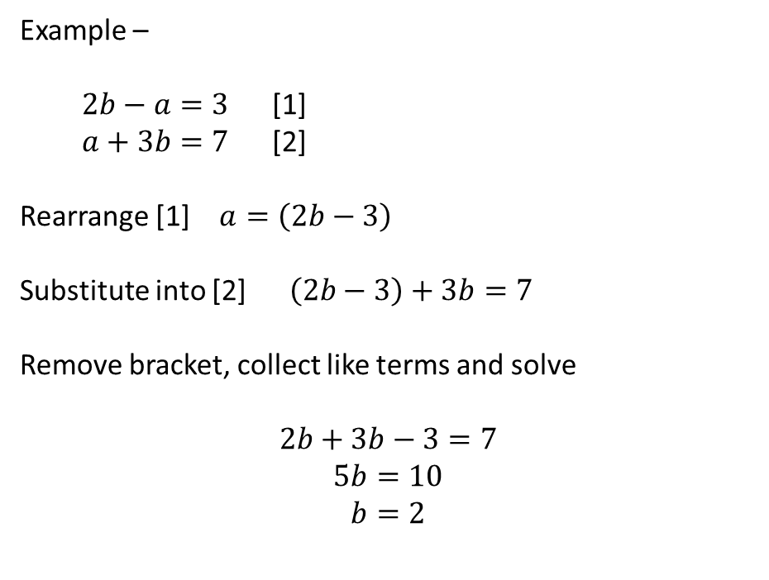
24
7
30
Date
Solving Simultaneous Equations
EQ – How do you use the substitution method.
How is it done
Example –
$2b−a=3$ [1]
$a+3b=7$ [2]
Rearrange [1] $a=\left(2b−3\right)$
Substitute into [2] $\left(2b−3\right)+3b=7$
Remove bracket, collect like terms and solve
$$2b+3b−3=7$$
$$5b=10$$
$$b=2$$
Number the equations
Bracket
5
Notes:
Input

Slide 7

24
7
30
Date
Solving Simultaneous Equations
EQ – How do you use the substitution method.
Where $b=2$
$$a=2b−3$$
$$a=\left(2×2\right)−3$$
$$a=4−3$$
$$a=1$$
Check ($a=1;b=2)$
[1] $2b−a=3$ [2] $a+3b=7$
$\left(2×2\right)−1=3$ $1+\left(3×2\right)=7$
$4−1=3$ $1+6=7$
5
Notes:
Input

Slide 8
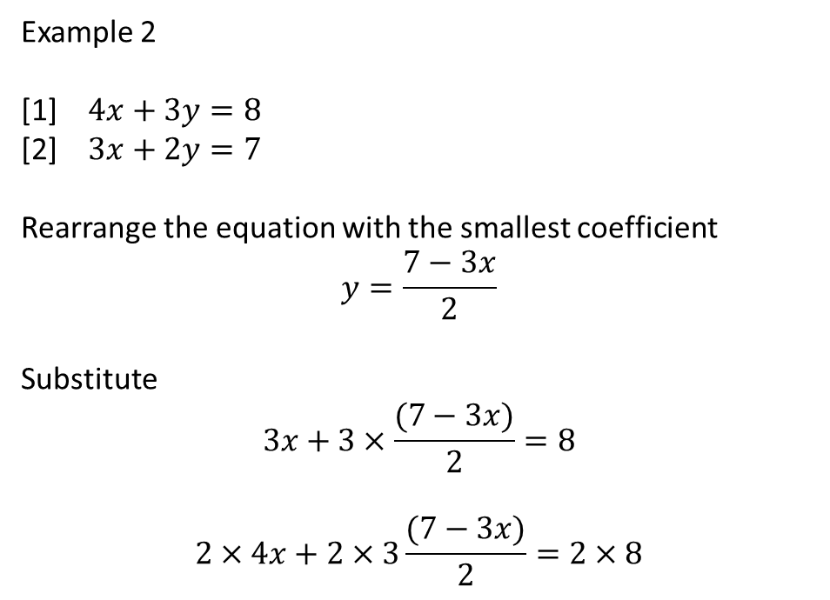
24
7
30
Date
Solving Simultaneous Equations
EQ – How do you use the substitution method.
Example 2
[1] $4x+3y=8$
[2] $3x+2y=7$
Rearrange the equation with the smallest coefficient
$$y=\frac{7−3x}{2}$$
Substitute
$$3x+3×\frac{(7−3x)}{2}=8$$
$$2×4x+2×3\frac{(7−3x)}{2}=2×8$$
5
Notes:
Input

Slide 9

24
7
30
Date
Solving Simultaneous Equations
EQ – How do you use the substitution method.
$$8x+3\left(7−3x\right)=16$$
$$8x+21−9x=16$$
$$21−x=16$$
$$x=5$$
Solve for $y where x=5$
$$y=\frac{7−3x}{2}$$
$$y=\frac{7−15}{2}$$
$$y=\frac{−8}{2}$$
$$y=−4$$
5
Notes:
Input

Slide 10
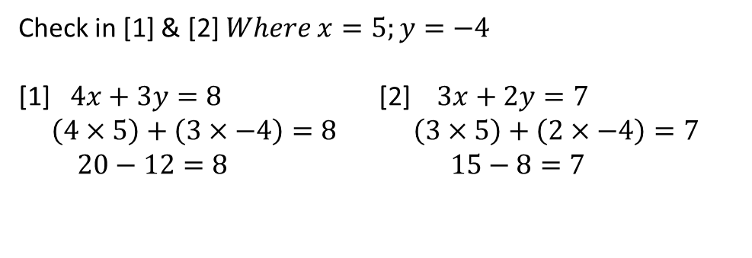
24
7
30
Date
Solving Simultaneous Equations
EQ – How do you use the substitution method.
Check in [1] & [2] $Where x=5;y=−4$
[1] $4x+3y=8$ [2] $3x+2y=7$
$\left(4×5\right)+\left(3×−4\right)=8 \left(3×5\right)+\left(2×−4\right)=7$
$20−12=8 15−8=7$
5
Notes:
Input

Slide 11
Check for understanding
Notes:
Check for understanding

Slide 12

Guided Practice
Nelson page 540 Q5f
[1] $c=3d−1 \& 5c−7d=19$ [2]
Use [1] $c=3d−1$ no rearranging required
$$5\left(3d−1\right)−7d=19$$
$$15d−5−7d=19$$
$$8d−5=19$$
$$8d=24$$
$$d=3$$
$$c=3×3−1=8$$
$$\left(5×8\right)−\left(7×3\right)=19$$
$$40−21=19$$
Notes:
Guided practice

Slide 13
Activity
Nelson Page 540
Question 5 except (f)
Notes:
Independent practice

Slide 14
Closure activity
Thumbs up
Notes:
Closure

